Slide 1
BB2920: Genetics
Prof. Farny
Lecture 8
1/31/17
Conference tomorrow – get a head start on PS3!
Office Hours this week: Friday 10-11, GH203C
PLA help hours: Thursday 7-9 SL lounge (PS3 due Friday 3pm)

Slide 2
What to do about JC1?
add the points to the participation grade
add the points to the other JC quizzes
Make up the JC during the conference after exam 2

Slide 3
Today’s Learning Objectives
Understand the stages of mitosis
Understand the stages of meiosis
Explain and discuss the differences between mitosis and meiosis
Explain how meiosis generates variation:
Crossing over between homologous chromosomes
Independent assortment of chromosomes

Slide 4
Have you studied mitosis and meiosis?
Yes, many times, I’m very comfortable with this content
Yes, but only once or twice and I’m a bit rusty
No, never before today

Slide 5
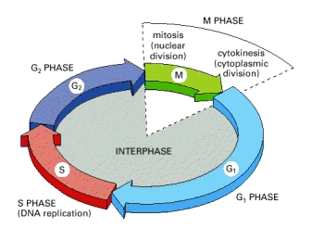
Mitosis: cell division that results in offspring (daughter) cells that are identical to the parent cell
The Cell Cycle regulates cell growth, DNA replication and mitosis
M = mitosis
cell division
2n
G2=Gap 2
cell growth
4n
G0 = no growth
(e.g., neurons)
S = synthesis
DNA replication
4n
G1 = Gap 1
cell growth
2n
G1 + S + G2 = interphase (human cell average ~23hrs)
Cell grows, duplicates DNA, RNA, proteins and organelles in preparation for M phase
M phase – mitosis, human cell ~1hr.

Slide 6
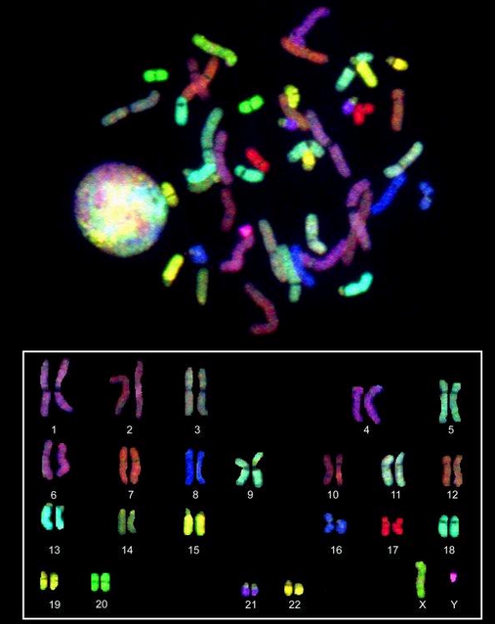
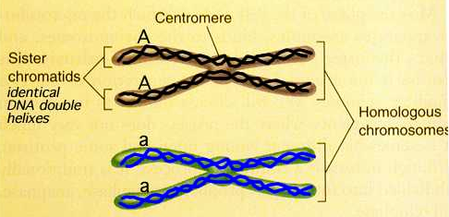
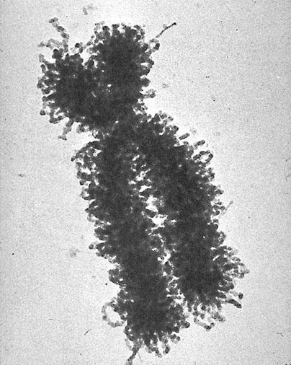
S phase
DNA replication results in two identical copies of each chromosome
genomes = 4n
Chromosome copies attach to each other at the centromere
Associated copies are called sister chromatids
homologous chromosomes
Human Chr. 7
sister chromatids

Slide 7
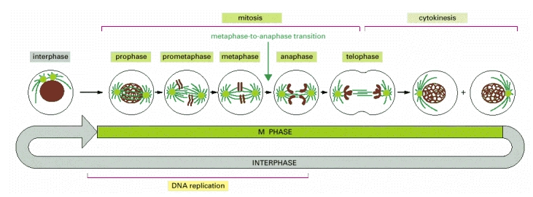
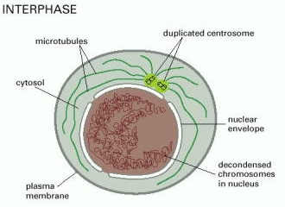
Mitosis proceeds in distinct stages
Interphase, at the end of G2
DNA, proteins, organelles have been duplicated
Centrosome is also duplicated (aka spindle pole or microtubule organizing center, important for positioning chromosomes for cell division)

Slide 8
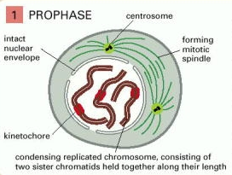
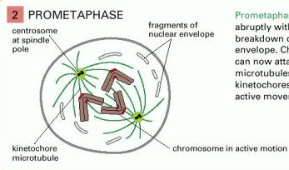
Mitosis begins
Prophase
Chromosome condensation
Sister chromatids are tightly bound together
Centrosomes move to opposite sides of the cell
mitotic spindle begins to form: microtubules radiating from the centrosomes
Prometaphase (sometimes called “late prophase”
nuclear envelope rapidly and suddenly breaks down
chromosomes attach to mitotic spindle at the kinetochore (protein complex at the centromere)

Slide 9
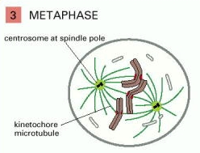
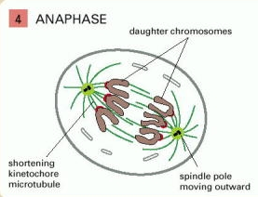
Mitosis continued
Metaphase
chromosomes are pushed and pulled by the microtubules of the mitotic spindle
align on the metaphase plate
microtubules are attached to opposite sides of each kinetochore, one per sister chromatid
Anaphase
the mitotic spindle pulls the sister chromatids apart, toward the centromeres (spindle poles)
spindle poles move farther apart

Slide 10
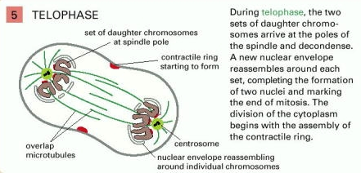
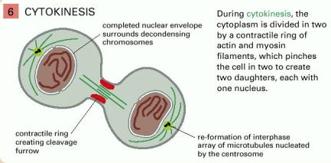
Mitosis concludes and two daughter cells are formed
Telophase
chromosomes begin to decondense
new nucleus forms around each set of chromosomes
Mitosis ends, cytoplasm is still attached
Cytokinesis
the cytoplasm is divided in half by the squeezing of a protein structure called the contractile ring
chromosomes are completely decondensed into their interphase state
nuclei completely formed

Slide 11
Break-out!
(part 1)

Slide 12
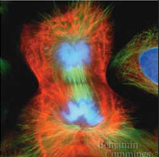
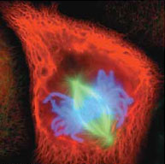
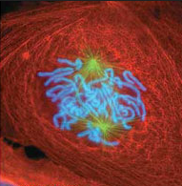
Below are fluorescence microscopy images of dividing breast cancer cells. What phase of mitosis is each cell in? (Be prepared to defend your choices! What features of the image support your conclusion?)
Blue = chromosomes
Red = actin cytoskeleton
Green = microtubules

Slide 13
What phase of mitosis this cell in?
Interphase
Prophase
Prometaphase
Metaphase
Anaphase
Telophase
4

Slide 14
What phase of mitosis this cell in?
Interphase
Prophase
Prometaphase
Metaphase
Anaphase
Telophase
19

Slide 15
What phase of mitosis this cell in?
Interphase
Prophase
Prometaphase
Metaphase
Anaphase
Telophase
19

Slide 16
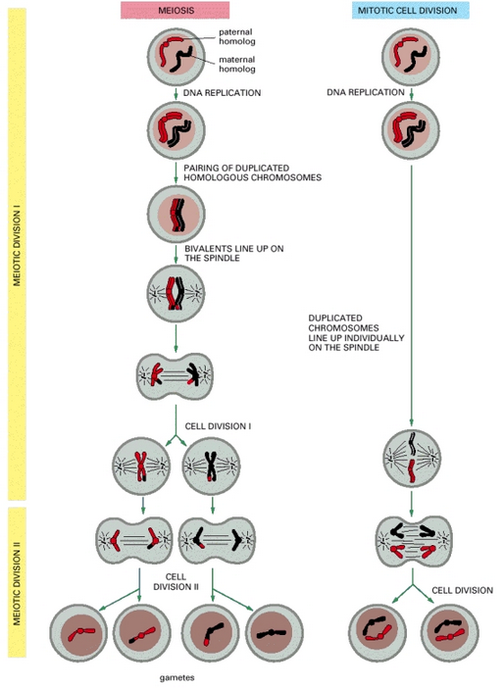
Meiosis consists of two sequential cell divisions and results in haploid gametes
Meiocytes: diploid precursor cells that undergo meiosis to form gametes
can rest in a G0 state for days, years, decades
NOTE: in humans, males
produce 4 gametes, females produce only 1 plus 3 non-viable cells (polar bodies)

Slide 17
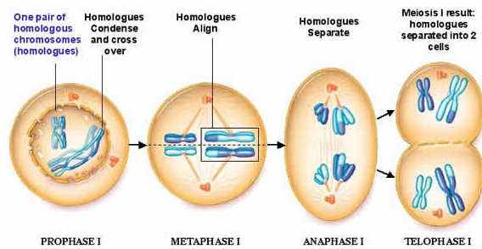
Meiosis I: separation of homologous chromosomes
kinetochores attach to microtubules on one set of sister chromatids
2n, but cells are technically haploid
(WHAT??!! I’ll explain further in a minute…)
- homologs pair
- crossing over between non-sister chromatids
homologs (not sister chromatids!) are separated

Slide 18
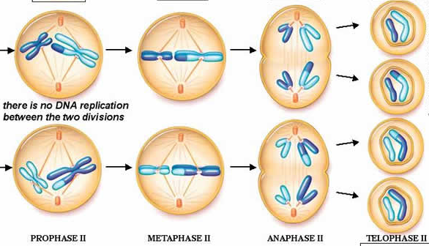
Meiosis II: separation of sister chromatids
brief interphase, nuclei may briefly reform and break down again, centrosomes split in half and relocate for second cell division
kinetochores now attach to opposite sides of each sister chromatid
division proceeds similar to mitosis, sister chromatids separate

Slide 19
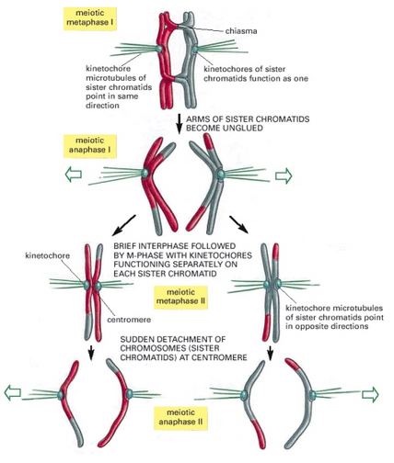
Kinetochores function differently in Meiosis I and Meiosis II

Slide 20
Ploidy vs. “n” (genome copies)
Genome = one complete copy of all the DNA of an organism
Ploidy = number of individual copies of the genome present
A sister chromatid is a copy of the genome, but its not a different copy of the genome!
Homologous chromosomes have the same genes in the same order, but have numerous differences (polymorphisms) so these are considered different copies of the genome
“n” refers to total copies, ploidy refers to different copies

Slide 21
Meiosis I: separation of homologous chromosomes
kinetochores attach to microtubules on one set of sister chromatids
2n, but cells are technically haploid
(WHAT??!! I’ll explain further in a minute…)
- homologs pair
- crossing over between non-sister chromatids
homologs (not sister chromatids!) are separated

Slide 22
Break-out!
(part 2)

Slide 23
Human somatic cells have 46 chromosomes.
For each of the following stages of meiosis, state the number of genome copies (“n”) and the ploidy (haploid or diploid) of the cell (NOTE: we consider the daughters to be separate cells after the completion of anaphase)
Prophase I
Telophase I
Telophase II

Slide 24
In Prophase I, a human meiocyte is:
4n, diploid
4n, haploid
2n, diploid
2n, haploid
n, diploid
n, haploid

Slide 25
In Prophase II, a human meiocyte is:
4n, diploid
4n, haploid
2n, diploid
2n, haploid
n, diploid
n, haploid

Slide 26
In Telophase II, a human meiocyte is:
4n, diploid
4n, haploid
2n, diploid
2n, haploid
n, diploid
n, haploid

Slide 27
Meiosis generates variation in two distinct and important ways
Crossing over between homologous chromosomes https://youtu.be/BhJf9MHHmc4
Independent assortment of homologous chromosomes http://youtu.be/wAHEejRUQdw

Slide 28
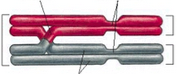
Crossing over occurs during Prophase I
chiasma
centromeres
Replicated paternal homolog of chromosome
Bivalent
(tetrad)
Replicated maternal homolog of chromosome
Sister chromatids (dyad)
Vocabulary:
Replicated sister chromatids = dyad
homologous chromosomes (paired dyads) = bivalent (tetrad)
the crossed over structure is known as a chiasma (pl. chiasmata)
Crossing over event is formally known as synapsis
Prophase I is longer than other phases, allows time for crossing over to occur
crossing over only occurs between non-sister chromatids (Why? What’s the difference?)
The DNA duplex is broken in the same (or similar) place and re-joined to the non-sister chromatid (as in the video)
Generates variation in the genome
Can lead to large insertions/deletions, other mutations

Slide 29
Meiosis generates variation in two distinct and important ways
Crossing over between homologous chromosomes https://youtu.be/BhJf9MHHmc4
Independent assortment of homologous chromosomes http://youtu.be/wAHEejRUQdw

Slide 30
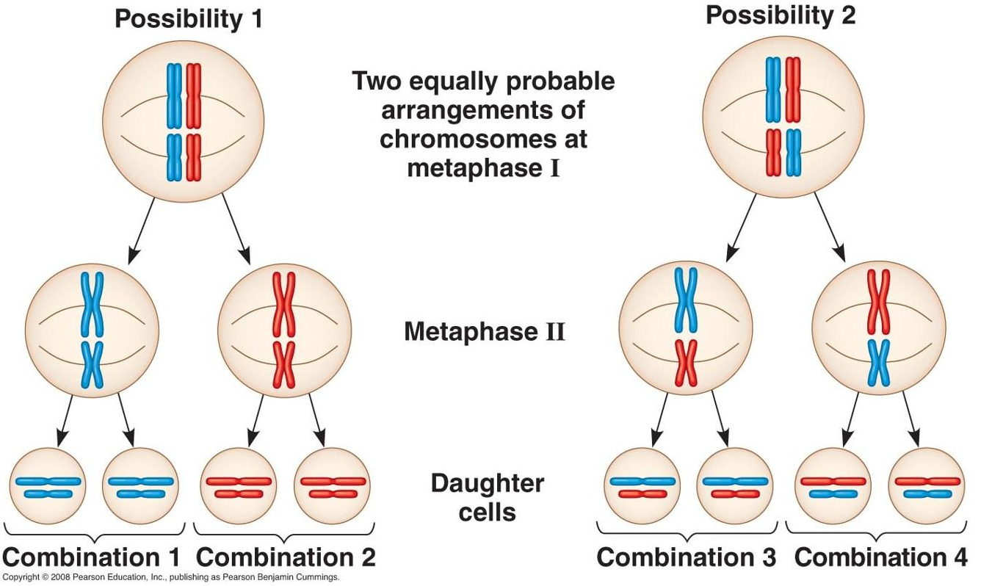
Independent assortment of homologous chromosomes in Meiosis I
maternal and paternal copies of chromosomes can separate into either cell during meiosis I
Occurs completely randomly, based on how the bivalents align on the metaphase I plate
possible gametes = 2^{n} (n=haploid chromosome #)

Slide 31

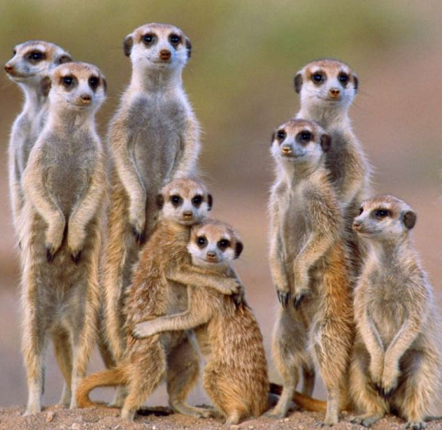
In meerkats, the diploid chromosome number is 36. How many possible different types of sperm could a male meerkat produce just by independent assortment of chromosomes?
Rank | Responses
1
2
3
4
5
6

Slide 32
Meiosis: Summary important points
Pairing, crossing over in Prophase I, major source of genetic variation
Segregation of homologous chromosomes in Anaphase I (NOT sister chromatids!)
Independent assortment of homologs in Meiosis I, creates significant variation
Nice video summary of meiosis, crossing over, and independent assortment: http://youtu.be/rqPMp0U0HOA

